Slide 1
Office of Finance and Administration

Slide 2
Office of Finance & Administration
Boyd Campus Center near the Dining Hall
Hours 8:30 – 4:30
Staff:
Lindsay Sands - Student Accounts Supervisor
Michele Hedspeth - Student Accounts Coordinator
Gwen Mikeals – Student Accounts Specialist & Cashier

Slide 3
Tuition & Fees
Fall 2021 bills are available online:
Payment due by August 6, 2021
Bills will reflect all finalized financial aid
View at www.vwu.edu via MyBeacon>Bill Payment
Payment Options:
Online ACH (no fee) and credit card payments through
Bill Payment (with a 2.85% convenience fee for credit
cards). Online payment is the University’s preferred
payment method
Check (mail/dropbox)
Payment Plans – Interest-free through Bill Payment
International Wires can be made via TransferMate

Slide 4
Action Required
Student Health Insurance:
All students are required to have health insurance
Provide proof of insurance and/or insurance waiver by August 31, 2021. The online waiver can be found at www.firststudent.com
All students will be charged until a waiver is completed
VWU offers health insurance through United Healthcare
The annual cost is $2,286
Coverage is from August 1, 2021 through July 31, 2022
If not waived by the August 31, 2021 deadline, the health insurance fee will not be refunded

Slide 5
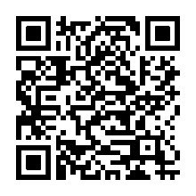
Action Required
Financial Responsibility Agreement Form (FRA):
formerly known as Disclosure of Tuition Form (DTF)
The FRA form acknowledges that the student accepts full responsibility of tuition and fees and other associated costs assessed as a result of registration and/or receipt of services. Acceptance of these terms constitutes a promissory note agreement to pay student’s financial obligation
The FRA form can be found online using the code below. The completed form is due no later than August 24, 2021.

Slide 6
Marlin $
An optional debit account to be used on campus
Scribner University Store
Boyd Dining Hall
Harbor Grille
Coastal Market
The student ID card is used for Marlin $
Money can be added to the Marlin $ card in various ways:
Online : https://www.vwu.edu/about/campus-offices/finance-and-administration/marlin-card.php
Transfer: If your tuition account reflects a true credit, funds can be transferred if requested
In person: Using the dropbox to drop off your check. ( No cash)
Money placed on the Marlin $ account will roll over from year to year

Slide 7
Semester Meal Plans
Meal plans are associated with your housing
15 meal plan = 15 meals per week + 100 bonus points
10 meal plan = 150 meals + 125 bonus points
7 meal plan = 7 meals per week +75 bonus points
*Meal plans cannot be reduced
Commuter Meal Plans per semester
80 meals + 80 bonus points
60 meals + 60 bonus points
40 meals + 40 bonus points

Slide 8
Refunds
Refunds are based on the date you notify the Registrar’s Office that you are withdrawing from classes
Refund Policy:
Prior to the first day of classes – 100% refund of tuition/room/board
First week of classes – 90% refund of tuition/room/board
Second week of classes – 50% refund of tuition/room/board
Third week of classes – 25% refund of tuition/room/board
After the third week of classes – no refund
* Fees are non refundable

Slide 9
MyBeacon
Go to www.vwu.edu, choose MyBeacon at the top of the page.
Then click on Bill Payment.

Slide 10
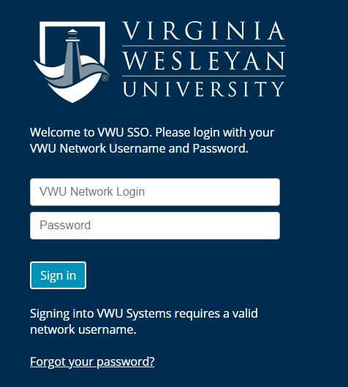
After you select Bill Payment, the below screen will appear. Enter your VWU Network Login and password.

Slide 11
Tools Offered within Bill Payment
View your account activity
Add Authorized User(s), i.e. parent/guardians
Set up your Payment Profile
Enroll in a semester payment plan
Complete international wire payments
Enroll into the tuition insurance

Slide 12
View your account activity, add Authorized User, set up your Payment Profile and Enroll in a Payment Plan

Slide 13
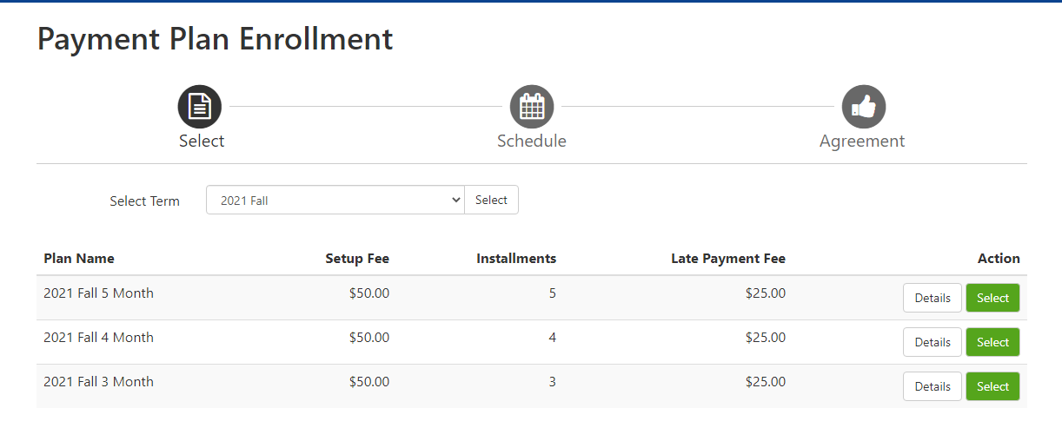
Payment Plans
VWU offers three interest-free semester payment plans:
5 month plan begins on July 10th
4 month plan begins on August 10th
3 month plan begins on September 10th

Slide 14
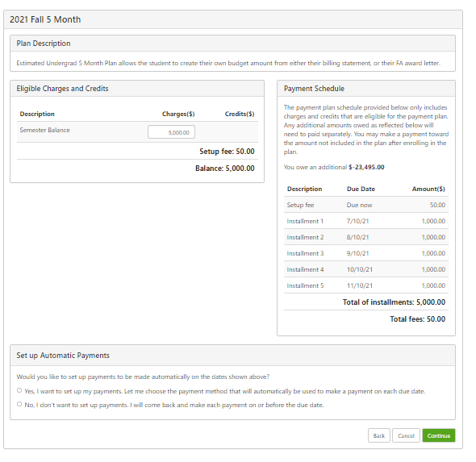
Each plan has a $50 set up fee due at time of registration
You will be charged a $25 Late Payment Fee if past due

Slide 15
International Wire Transfer
International Wire Transfer – At VWU we know that our international students often have to pay significant transfer fees when paying for their tuition, fees and expenses. We listened to your challenges, so we've teamed up with TransferMate to provide you a transparent payment method to reduce additional bank fees and improve your payment experience. TransferMate helps international students pay tuition and fees in their local currency from any country.
How to make a payment: https://touchnetvirginiawesleyanuniversity.transfermateeducation.com/

Slide 16
Tuition Insurance GradGuard
The Tuition Insurance Plan* helps students and their families overcome the financial losses that may result from events which force students to withdraw from the semester due to a covered medical reason. Helping families get the most out of your Virginia Wesleyan University experience is always our top priority.
This Tuition Insurance Plan* supplements our refund policy by reimbursing students for tuition, housing, and other fees if a student withdraws for any covered medical reason at any time during the semester. The Tuition Insurance Plan* also includes Student Life Assistance providing 24-hour assistance to help our students and their families stay safe on and off campus.
More Information: Logon to gradguard.com/tuition/school or call 877-794-6603

Slide 17
Recap
View Fall 2021 bill online
www.vwu.edu via MyBeacon>Bill Payment
Payments are due August 6, 2021
Add an Additional User(s), i.e. parent/guardians
Enroll in a semester payment plan
Enroll/waive health insurance by August 31, 2021 at www.firststudent.com
Enroll into the tuition insurance by August 24, 2021

Slide 18
Complete the online FRA form no later than August 24, 2021.
Office of Finance and Administration email: finance@vwu.edu
Stay safe, stay well and welcome to the Marlin family!

